Slide 1
Big Data Analytics with MongoDB
MongoDB
MongoDB is a document-oriented NoSQL database used for high volume data storage. It is a cross-platform document database that provide high performance, high availability and easy scalability.
It works on the concepts of collections and documents. Collection means a group of MongoDB documents.
Collection do not enforce schema. Document within a collection can have different fields
Document is a set of key-value pairs. Documents have a dynamic schema.
Comparison between RDMS & MongoDB

Slide 2
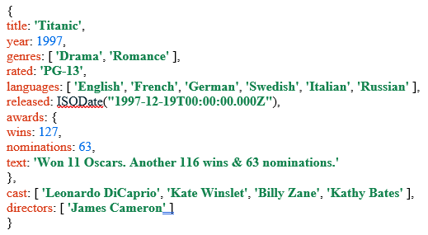
Big Data Analytics with MongoDB
Features of MongoDB
It is schemaless document database
It has clear object structure
It has no complex join
It has deep-query ability which supports document-based language
It is more scalable
It uses internal memory for storing working data sets.
Why MongoDB?
It is document oriented storage, it sores data in the form of JSON – JavaScript Object Notation
It provides index to any attributes
It provides replication and high availability of data
It has auto-sharding mechanism
It has powerful queries
Sample Document

Slide 3
Big Data Analytics with MongoDB
MongoDB Installation
To install MongoDB on Windows, first download the latest release of MongoDB from http://www.mongodb.org/downloads.
Once you have finished installed the mongodb, to get your Windows version, open command prompt and execute the following command. “mongod –version”
MongoDB Shell
The MongoDB shell is an interactive JavaScript-based interface to interact with a MongoDB database.
It allows users to execute database commands, perform CRUD (Create, Read, Update, Delete) operations, and manage the database server.
Thus, to work with MongoDB smoothly you need to install MongoDB Shell.
You can download the MongoDB Shell via this link: https://www.mongodb.com/try/download/shell Note: make sure you choose msi package type to get the executable file setup.
Once you have finished the installation, to get access into MongoDB via mongodb sell, go to cmd commond prompt, type the command “mongosh” then press enter.

Slide 4
Big Data Analytics with MongoDB
MongoDB - Creating new database
The use Command
MongoDB use DATABASE_NAME to create database. The command will create a new database if it doesn't exist, otherwise it will return the existing database.
Syntax
Basic syntax of use DATABASE statement is as follows:
Use database FDS
To check your currently selected database, use the command db
db

Slide 5
Big Data Analytics with MongoDB
MongoDB - Commands
The show Command
To see a list of database, use the command show dbs.
→Show dbs
The insert Command
NOTE: A blank created database is not listed in the available database list, you need to insert at least one document into it.
>db.studentList.insert({"name":“Ali Khelef“,”age”:39})
Drop Database Command
MongoDB use db.dropDatabase() command to drop an existing database.
Syntax
Basic syntax of dropDatabase() command is as follows:
>db.dropDatabase()

Slide 6
Big Data Analytics with MongoDB
MongoDB - Commands
Create collection Command
The createCollection() Method
MongoDB use db.createCollection(name, options) to create collection.
Syntax
Basic syntax of createCollection() command is as follows:
>db.createCollection(“Staff”)
NOTE: In MongoDB, you don't need to create collection. MongoDB creates collection automatically, when you insert some document.
Drop Collection Command
The drop() Method
MongoDB use db.collection_name.drop() command to drop an existing collection.
Syntax
Basic syntax of drop() command is as follows:
>db.Staff.drop()

Slide 7
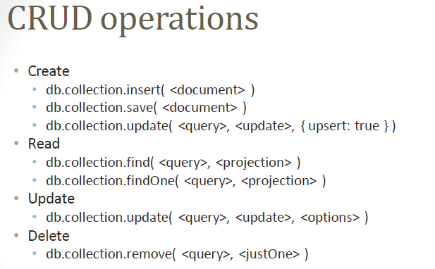
Big Data Analytics with MongoDB
MongoDB - CRUD Commands

Slide 8
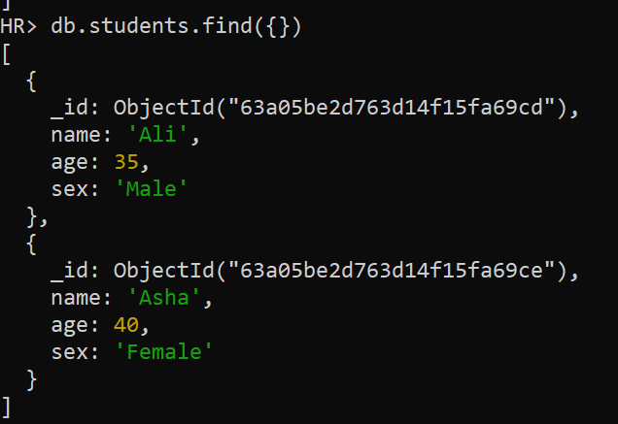
Big Data Analytics with MongoDB
MongoDB - CRUD Commands
Select All Documents
To select all documents in the collection, pass an empty document as the query filter document to the db.collection.find() method
That is: db.collection_name.find({}}
For example: db.students.find({})

Slide 9
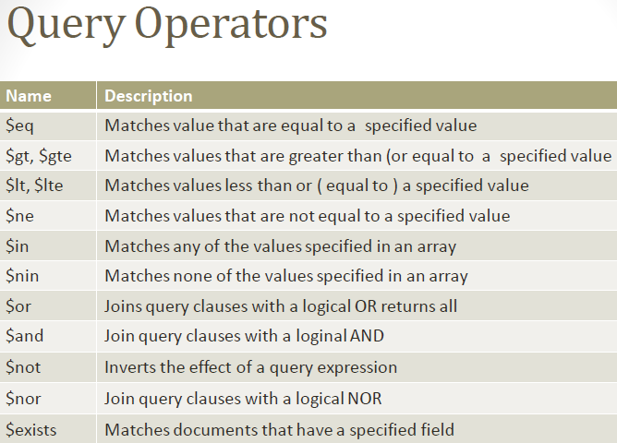
Big Data Analytics with MongoDB
MongoDB - QUERY Commands

Slide 10
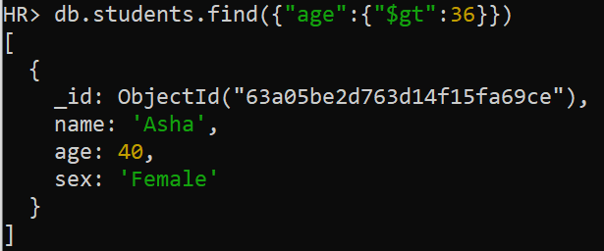
Big Data Analytics with MongoDB
MongoDB - CRUD Commands
Fitering Datat based on logical condition
For example to select all students from students collection whose age is greater than 36 years.
db.students.find({“age”:{“$gt”:36}})

Slide 11
Big Data Analytics with MongoDB
NECTA-TASK: Group Exercise
(5 students @ 30 marks for one week, deadline: 6th Jan, 2025 at 16:00hrs)
Instruction for Submission: Prepare a short video clip demonstrating the way you achieve your answer. Then, submit a paper group list with your video clip before 6th Jan, 2025 at 16:00hrs
https://onlinesys.necta.go.tz/results/2022/acsee/index.htm
Problem: The director of NECTA want to get information about the performance of each subject in the ACESS school all over the country.
Assume you have been asked to extract a school result html page and load it into mongoDB. How can you do this task? (Hint: use any software tool of your choice that can help you to achieve your answer)

